Slide 1

Openvuln scanner & SECURITY framework

Slide 2
MEET OUR TEAM
MENTOR
Dr. SUGANTHI N
TEAM MEMBERS
SHARAT N
VISHAL S
RAJHESHWAR V

Slide 3
Project objective and scope of the project work
Our objective is to design a Security Framework for enterprise use. It is a GUI tool that takes user inputs and performs Open-Source Intelligence (OSINT) operation to generate a report of the various data collected using the respective tools.

Slide 4
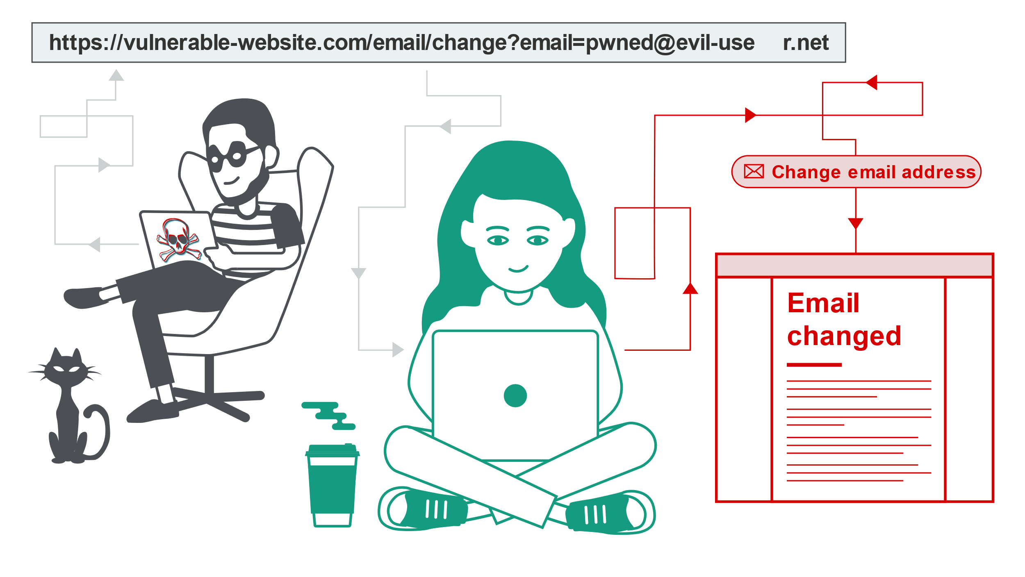
Introduction to area of the project
Many organizations activities operate via the internet this situation has further forced many organizations to use the internet for their daily operation, on the other hand, cybercriminals have gotten a chance for launching more attacks on many organizations.
Without the appropriate use of security, it leads to misconfiguration of network and deployment for vulnerable services, Which could lead to loss for the company with the advent of cyberattack in form of compromise of critical information stored in the organization systems. Hence, to prevent these damages, a viable framework is in demand. This project is based on Cybersecurity and security policies that should be followed in an Enterprise for safe functioning.

Slide 5
LITERATURE SURVEY
NIST Framework
NIST places a strong emphasis on utilising business objectives to direct cybersecurity efforts and taking cybersecurity risks into account as part of the organization's risk management procedures. When it comes to managing cybersecurity risk for critical infrastructure, there is no one solution that fits all. Organizations will still face distinct risks from various threats, vulnerabilities, and risk tolerances. They will also differ in how they adapt the Framework's recommended practises. [1]

Slide 6
LITERATURE SURVEY
Controlled Unclassified Information (CUI)
Federal agencies place a high priority on protecting Controlled Unclassified Information (CUI) stored in non-federal systems and organisations. In this paper, federal agencies are given suggested security standards for safeguarding CUI confidentiality. Federal agencies are expected to use the standards in contracts and other legal documents. It offers federal agencies suggested security standards for safeguarding the CUI in a system and organisation that are not federal. [2]

Slide 7
LITERATURE SURVEY
Cybersecurity Workforce Framework (NICE Framework)
The Cybersecurity Workforce Framework (NICE Framework), developed by the National Initiative for Cybersecurity Education (NICE), is a model for reference that explains the interdisciplinary nature of cybersecurity work. It acts as a key reference tool for outlining and exchanging knowledge about cybersecurity work and the knowledge, skills, and abilities (KSAs) required to finish projects that can improve an organization's cybersecurity posture.

Slide 8
LITERATURE SURVEY
Open-Source Intelligence (OSINT) - METHODOLOGY
Open-Source Intelligence (OSINT) is the gathering of information from publicly accessible, private and public sector sources about specific people or an organization for business intelligence objectives. These sources include the internet, emails, Twitter, Facebook, and other social media websites and apps. The risks, weaknesses, and effects of using social media sites have been the subject of much discussion and research, but this study aims to reduce prejudice. [8]

Slide 9
DRAWBACK OF EXISTING SOLUTION
No Single Comprehensive Tool
Expensive Commercial Tools
Free Tools with limitations
Lack of Integrated Framework

Slide 10
Details of the Proposed system
A framework that adheres to the International standards on network configuration and information management.
A GUI tool that provides an easy-to-use interface to assist the security standards in an organization with respected to our framework standards.
It culminates in the betterment of the security of the college/Enterprise using it.

Slide 11
SECURITY FRAMEWORK
CIA Triad
Periodic Risk Assessment
Information Access Management
Workforce Management
Datacenter and Device Security
Audit

Slide 12
MODULES
Network scanner
Domain details fetcher
SSL Certificate Details
OS Detection
Subdomain Enumeration
DNS, IP lookup
Geolocation of IP

Slide 13
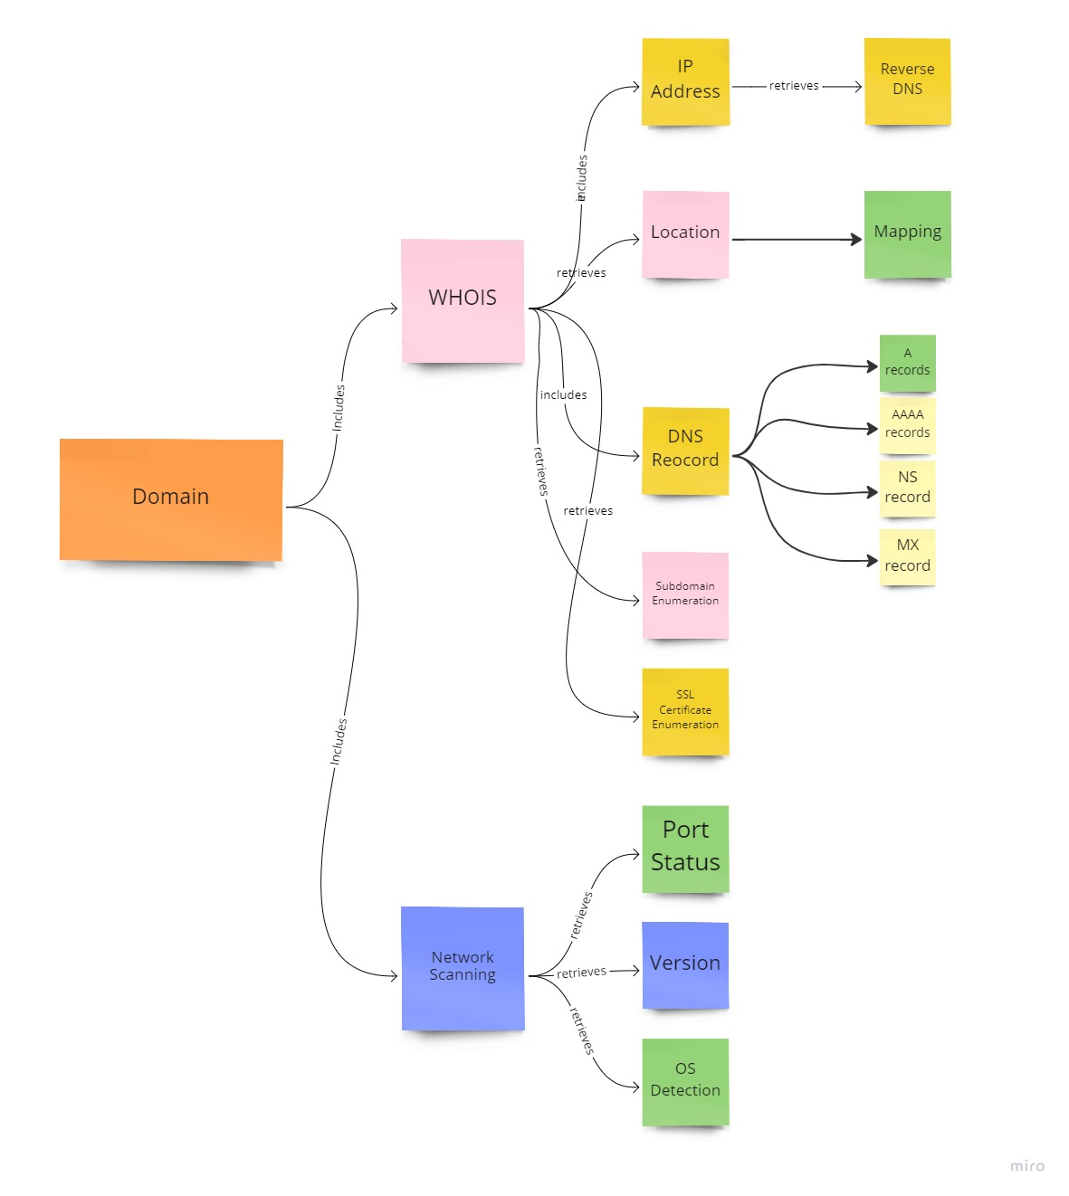
BLOCK DIAGRAM OF OSINT TOOL

Slide 14
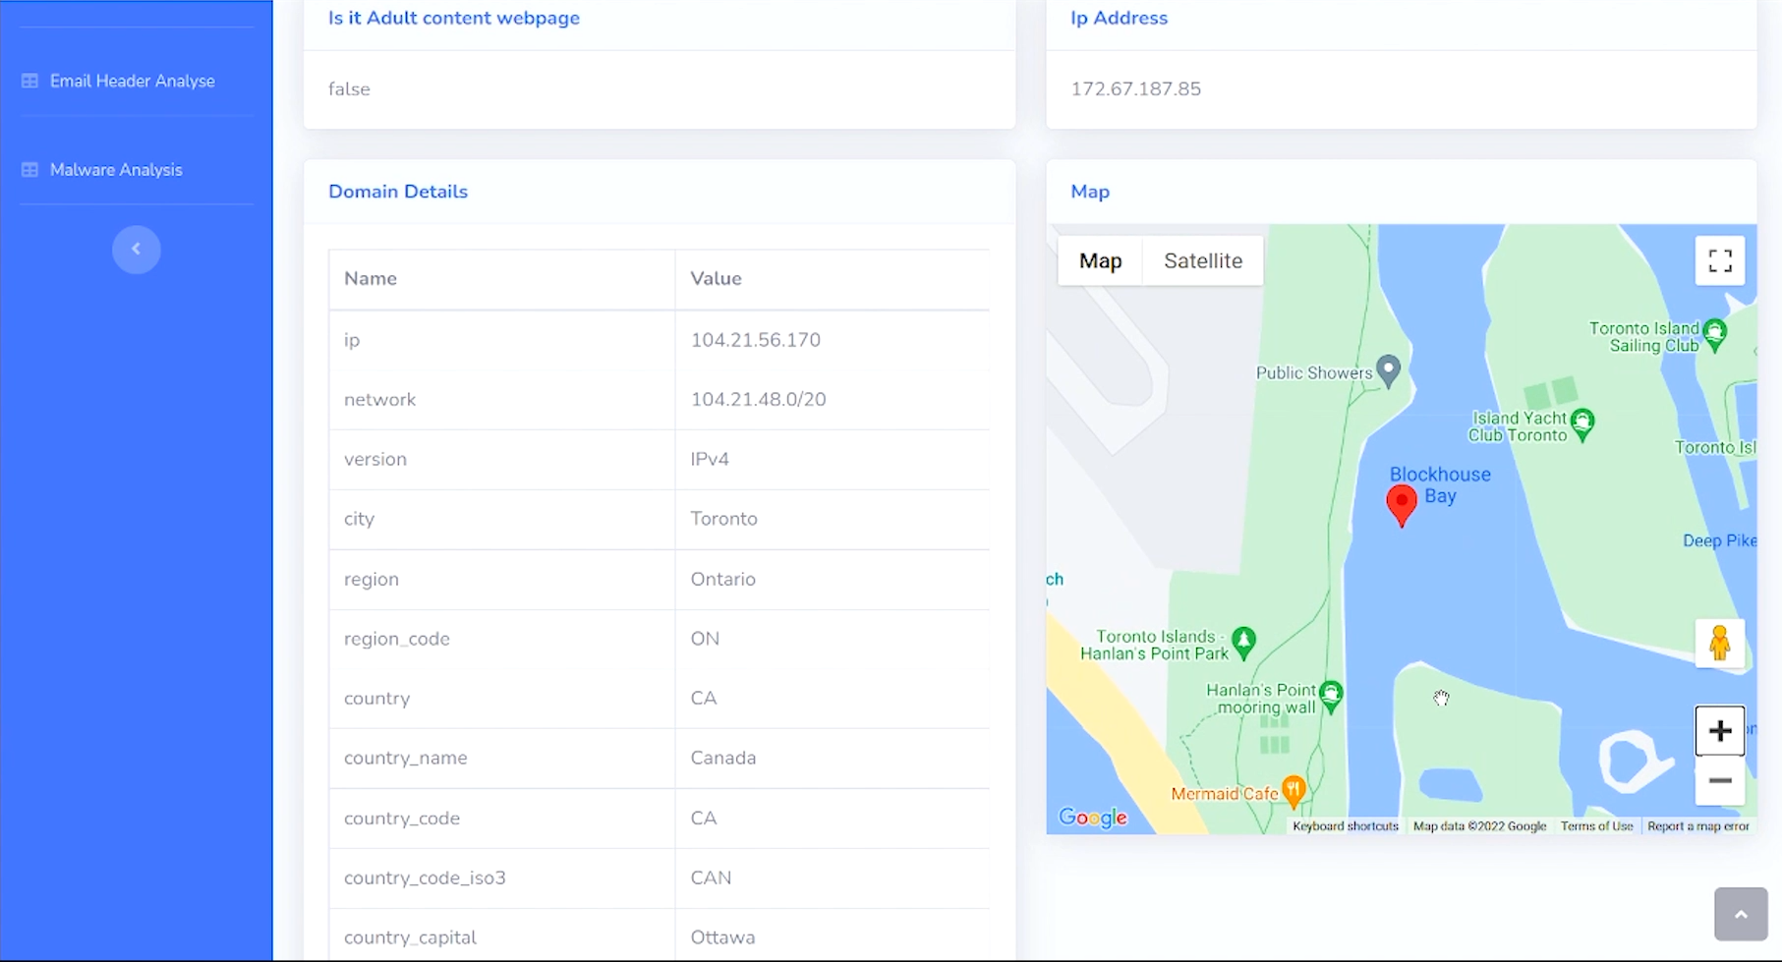
MAIN DASHBOARD

Slide 15
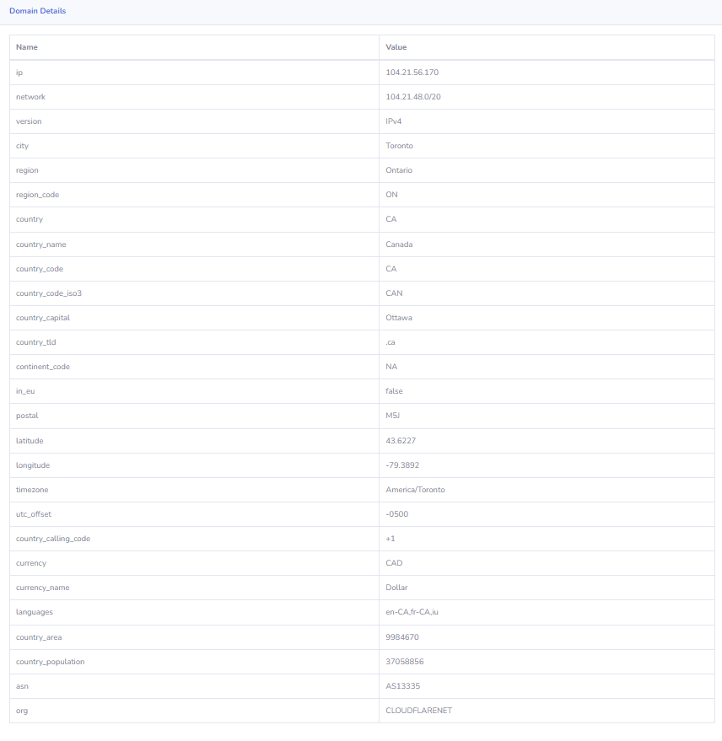
WHOIS Details

Slide 16
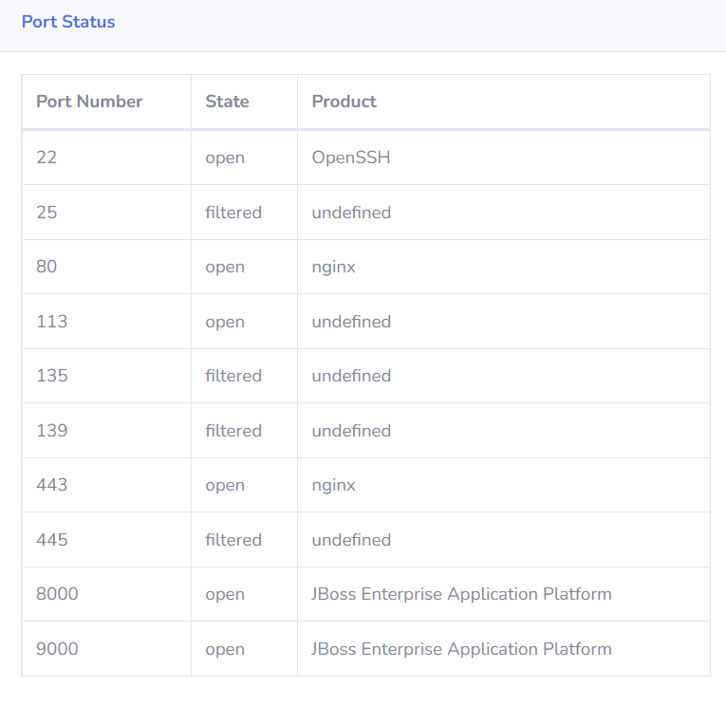
NMAP PORT SCAN

Slide 17
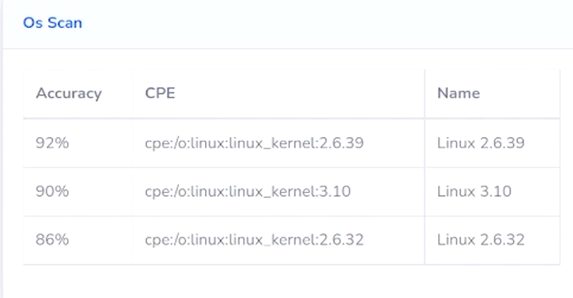
OS DETECTION

Slide 18
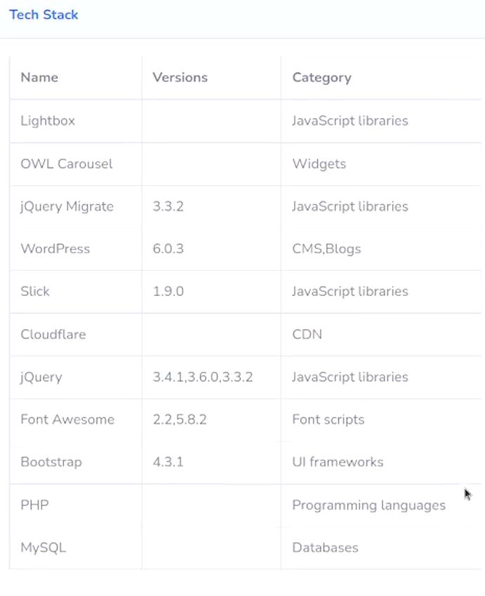
TECHNOLOGY STACK ENUMERATION

Slide 19
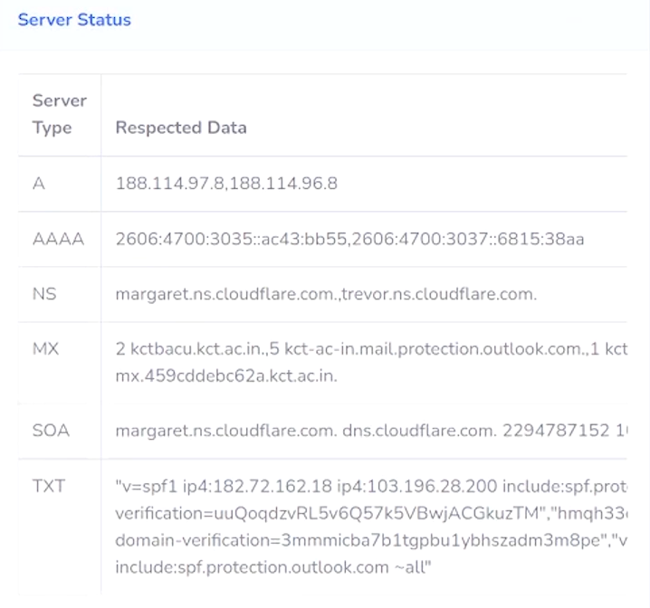
DNS ENUMERATION

Slide 20
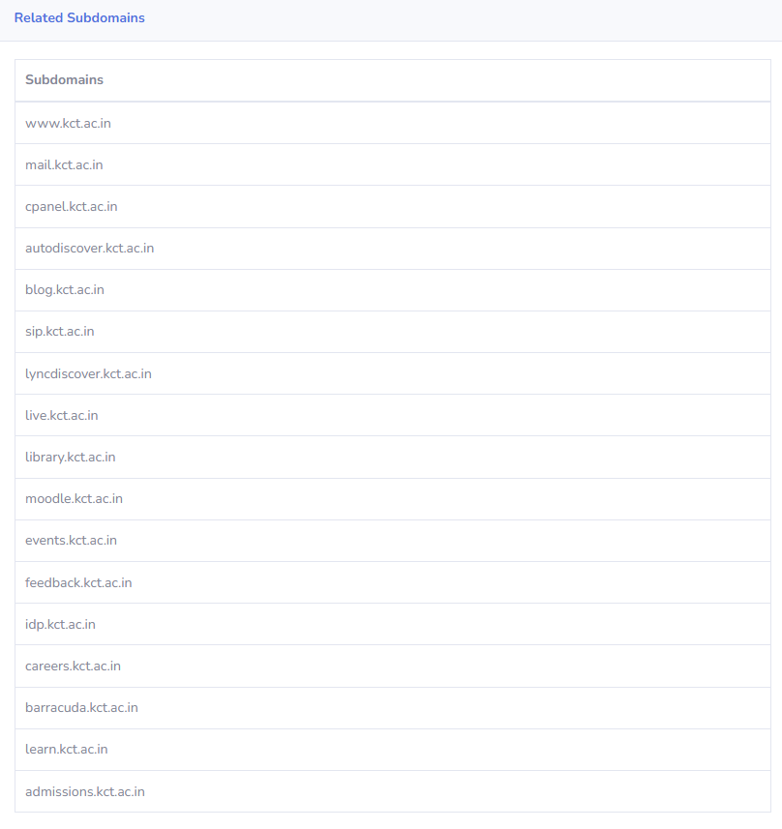
SUBDOMAIN ENUMERATION

Slide 21
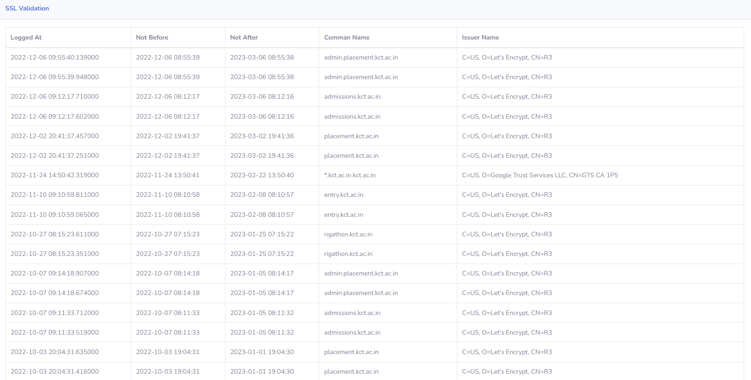
SSL CERTIFICATE ENUMERATION

Slide 22
TECHNOLOGY STACK
LANGUAGES
Python
HTML
CSS
JS
Bash
API
IP API
Wappalyzer
DNS For Family
Python Packages
Py-Nmap
DNS Resolver
Pycrtsh
FRAMEWORK
Django

Slide 23
ADVANTAGES
Feasible
Time efficient for Report Generation
Low-cost maintenance
Less resource consumption
Works in a very strategical manner

Slide 24
DISADVANTAGES
Comprehensive OSINT needs more time
Dependent Modules

Slide 25
CONCLUSION AND FUTURE WORKS
Extensive OSINT Tool
Malware Analysis
Email Header Analysis
Framework which includes Network Security, Application Security will be added
Performance Optimization

Slide 26
REFERENCES
https://secureframe.com/blog/security-frameworks
https://nvlpubs.nist.gov/nistpubs/SpecialPublications/NIST.SP.800-171r2.
https://nvlpubs.nist.gov/nistpubs/cswp/nist.cswp.04162018.pdf
https://www.researchgate.net/publication/356649134_IT_Governance_and_Information_Security_Guides_Standards_and_Frameworks
https://ieeexplore.ieee.org/abstract/document/8677327/
https://niccs.cisa.gov/workforce-development/nice-framework
https://www.researchgate.net/publication/303956311_The_Challenges_of_Cybersecurity_Frameworks_to_Protect_Data_Required_for_the_Development_of_Advanced_Maintenance

Slide 27
THANK YOU

